Slide 1
Irredundant Cover
After performing Expand, we have a prime cover without single cube containment now.
We want to find a proper subset which is also a cover (irredundant).

Slide 2

Irredundant Cover
Proposition:
A set of cubes C covers a cube p if and only if
C_{p} is a tautology.
proof:
=>
C
p = p
=>
(C
p)_{p} = p_{p}
=> C_{p}
p_{p} = 1
=> C_{p} = 1
C_{p} = 1
=> C_{P} P = P
=> C P = P
<=

Slide 3
Example
Ex: p = 1 1 2
C = 2 1 0
1 2 1
C_{p =} 2 2 0
2 2 1
Check tautology(C_{p})
If (C_{p}) is a tautology, C covers p.

Slide 4
Property of Unate Function
Proposition:
A unate cover is a tautology if and only if it contains a row of 2’s.
pf:
(<=) trivial
(=>) Assume the cover represent a monotone increasing function, the function contains 1’s and 2’s.
The minterm (0,0,....0) must be covered. Unless the cover contains (2,2,....2) , the minterm (0,0,...0) will not be covered.

Slide 5
Tautology Check
1. speed-up by unate variables
Let F(x₁,x₂,...x_{n}) , x₁ : positive unate
  F(x₁,x₂,...x_{n}) = x₁A(x₂,...x_{n}) + B(x₂,...x_{n})
  A : terms with x₁
  B : terms without x₁
  F_{x1} = A + B F_{x1}’ = B
  If (F_{x1’} = B) is tautology, F_{x1} = A + B is
a tautology.
  If (F_{x1’} = B) is not a tautology, F is not a
tautology.
If x is positive unate, test if F is a tautology.
<=> F_{x’} is a tautology

Slide 6

Tautology Check
2. Other techniques
  a row of 2’s, answer ‘Yes’
  a column of all 1’s or all 0’s, answer ‘No’
  compute an upper bound on the no. of
minterms of on-set
Ex: number of minterms
0 2 0 1 2
1 1 2 2 4
1 2 1 1 2
2^{n} = 16 > 8 answer ‘No’
n
7, test by truth table

Slide 7
Irredundant Cover
Primes in F
(1) relatively essential cube c of F (E)
F - {c} is not a cover
(2) redundant cubes
  Totally redundant (R_{t})
  a cube covered by relatively essential
  cubes and Don’t care
  Partially redundant (R_{p})

Slide 8

Example
Ex:
c₃
F ={c₁,c₂,c₃}
E = {c₁,c₃}
R_{t} = {c₂}
R_{p} = φ
c₂
c₁
c₄
c₃
F ={c₁,c₂,c_{3,}c₄}
E = {c₁,c₄}
R_{t} = φ
R_{p} = {c₂,c₃}
c₂
c₁

Slide 9

Irredundant Cover
(1) Check whether cubes are relatively essential
1. tautology (F-c)_{C}
2. If not tautology (F-c)_{c} , c is relatively
essential.
(2) Check partially, totally redundant
1. tautology (E
D)_{C} (D : don’t care)
2. If yes, c is
totally redundant
If no, c is
partially redundant

Slide 10

Irredundant Cover
(3) Minimal Irredundant (R_{p})
Find a minimum subset of partially irredundant
set such that combining with relatively essential
cubes, it forms a cover.
For each r
R_{p}, define the minimal set S
such that (R_{p} - S)
E
D is NOT a cover
ex:
c₄
R_{p} = {c₄,c₃,c₂}
S₄ ={{c₄,c₃}}
S₃ = {{c₃,c₄},{c₃,c₂}}
S₂ = {{c₂,c₃}}
c₃
c₅
c₂
c₁

Slide 11

Irredundant Cover
Define a matrix B. Each rows corresponds to a S_{i}
B_{ij} = 1 if R_{pj} in S_{i}
0 otherwise
Ex: R_{p} = {c₄,c₃,c₂}
S₄ = {{c₄,c₃}}
S₃ = {{c₃,c₄},{c₃,c₂}}
S₂ = {{c₂,c₃}}
c₂ c₃ c₄
S₄ 1 1
S_{3.1} 1 1
S_{3.2} 1 1
S₂ 1 1
minimum column cover of B
minimal irredundant cover

Slide 12
Irredundant Cover
Two things:
1. find minimal set S
2. find minimal column covering

Slide 13

Find Minimal Set S
For each r in R_{p}, find all minimal sets S
(R_{p} - S)
E
D does not cover r
Tautology((R_{p} - S)
E
D)_{r} is not a tautology.
Let A = (R_{p})_{r} B = (E
D)_{r}
A
B
1 determine all minimal subset S
A
such that (A - S)
B
1

Slide 14



Find Minimal Set S
Let E
D = φ
A = (R_{p})_{r}
taut(A)
If A is a unate cover with (A
1), then
there must be at least one row of 2’s in the
cover A
take S to be the set of all such cubes, then
A - S
1
else
binate select x_{j}
split A_{xj}, A_{xj’}
S_{xj}
taut(A_{xj})
S_{xj’}
taut(A_{xj’} )
merge: S = S_{x}
S_{x’}
(
(A-S)
1
(A_{x} -S_{x})
1 OR
(A_{x’} - S_{x’})
1 )

Slide 15


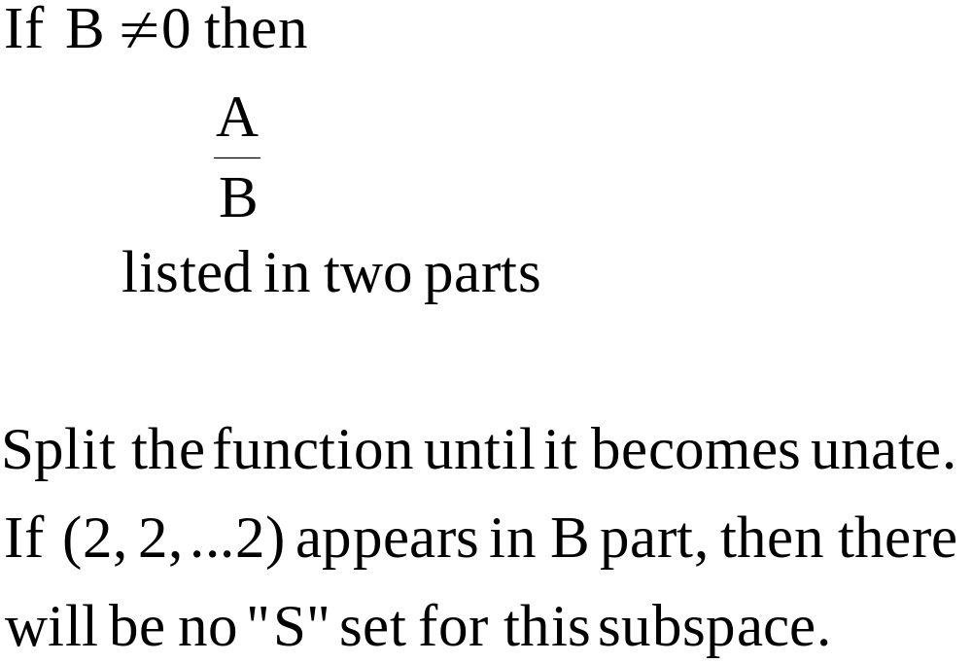
Irredundant Cover
Let A =(R_{p})_{r} B=(E
D)_{r}
A
B
1
find subset S
A such that (A - S)
B
1

Slide 16
Example
ex: A =(R_{p})_{r} B = φ
x₄x₅x₆
0 2 2(4) {{5,7},{5,6},{4,7},{4,6}}
1 2 2(5)
2 0 2(6)
2 1 2(7)
2 2 1(8)
1 2 1(9)
{{5,7},{5,6}}
x₄
x_{4’}
{{4,7},{4,6}}
2 2 2(5)
2 0 2(6)
2 1 2(7)
2 2 1(8)
2 2 1(9)
2 2 2(4)
2 0 2(6)
2 1 2(7)
2 2 1(8)
{5,6}
x₅
x_{5’}
{4,6}
{5,7}
x₅
x_{5’}
{4,7}
2 2 2(5)
2 2 2(7)
2 2 1(8)
2 2 1(9)
2 2 2(5)
2 2 2(6)
2 2 1(8)
2 2 1(9)
2 2 2(4)
2 2 2(7)
2 2 1(8)
2 2 2(4)
2 2 2(6)
2 2 1(8)

